Slide 1
Fluorescence Data Analysis
1-5-10uM and 1uM chips
8A current, 2 seconds exposure
Lucky Jordan

Slide 2
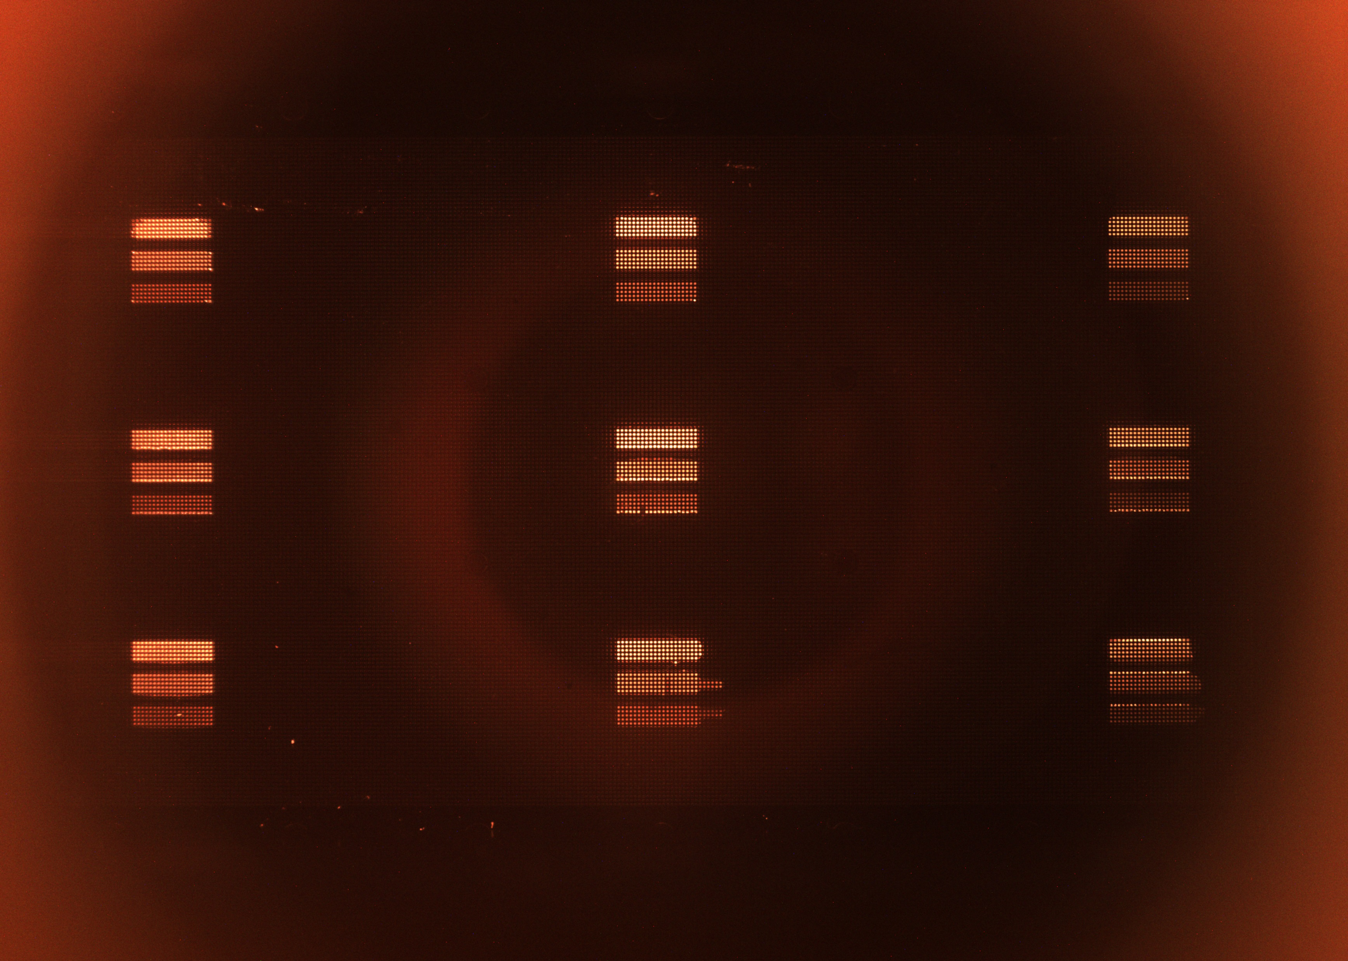
1-5-10uM chip
Left
Center
Right
Top
Middle
Bottom

Slide 3
16mm
25mm
35mm

Slide 12
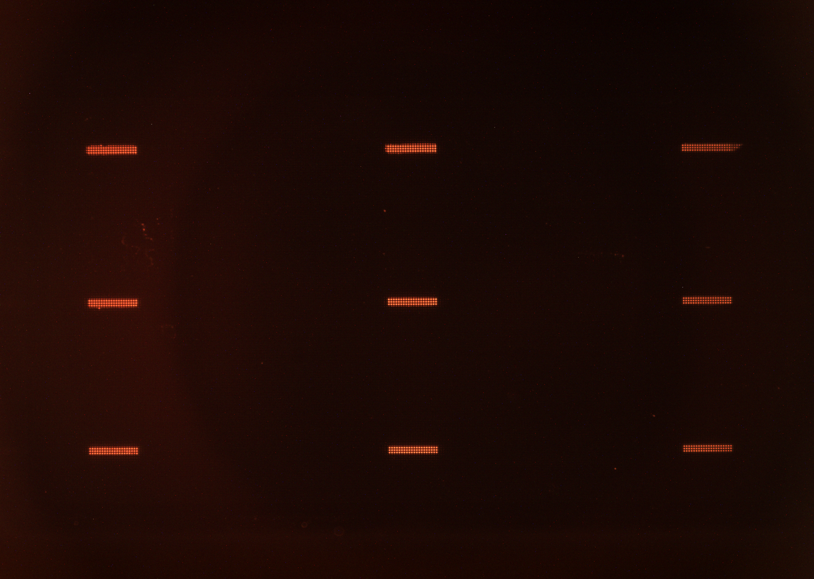
1uM chip
Left
Center
Right
Top
Middle
Bottom

Slide 22
1uM continued
The following slides compare data across as three lenses at maximum LED drive current with two different exposure times: 2 seconds and 5 seconds.

Slide 23
16mm/2s/8A
25mm/2s/8A
35mm/2s/8A
16mm/5s/8A
25mm/5s/8A
35mm/5s/8A

Slide 24
16mm/2s/8A
25mm/2s/8A
35mm/2s/8A
16mm/5s/8A
25mm/5s/8A
35mm/5s/8A

Slide 25
16mm/2s/8A
25mm/2s/8A
35mm/2s/8A
16mm/5s/8A
25mm/5s/8A
35mm/5s/8A

Slide 26
16mm/2s/8A
25mm/2s/8A
35mm/2s/8A
16mm/5s/8A
25mm/5s/8A
35mm/5s/8A

Slide 27
16mm/2s/8A
25mm/2s/8A
35mm/2s/8A
16mm/5s/8A
25mm/5s/8A
35mm/5s/8A

Slide 28
16mm/2s/8A
25mm/2s/8A
35mm/2s/8A
16mm/5s/8A
25mm/5s/8A
35mm/5s/8A

Slide 29
16mm/2s/8A
25mm/2s/8A
35mm/2s/8A
16mm/5s/8A
25mm/5s/8A
35mm/5s/8A

Slide 30
16mm/2s/8A
25mm/2s/8A
35mm/2s/8A
16mm/5s/8A
25mm/5s/8A
35mm/5s/8A

Slide 31
16mm/2s/8A
25mm/2s/8A
35mm/2s/8A
16mm/5s/8A
25mm/5s/8A
35mm/5s/8A

